Slide 1








•
Extracting Insights from Order, Delivery, and Campaign Data
Prepared by: Syed Abdul Bari
08/07/2026

Slide 2

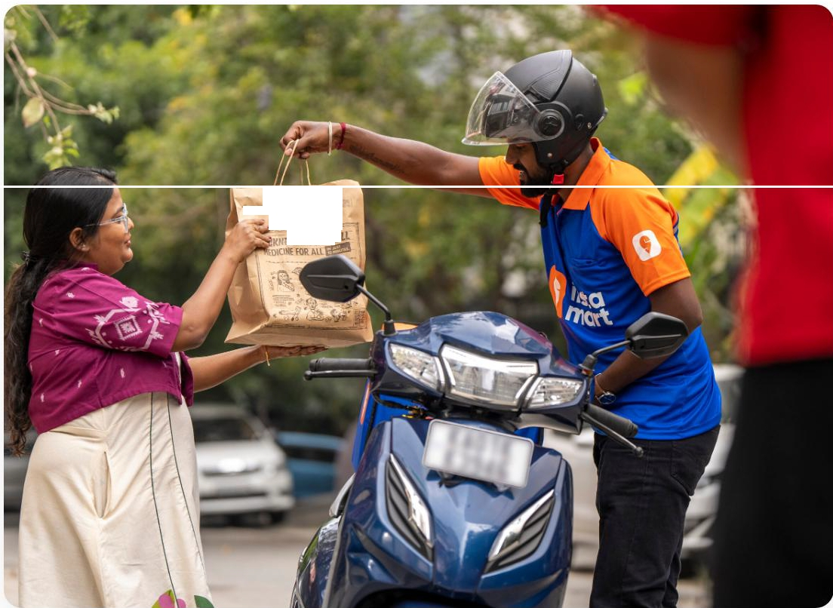
About Swi
Founded: 2014
Headquarters: Bangalore, India
Industry: Online Food Delivery & Quick Commerce
Swiggy is one of India's leading online food delivery platforms connecting customers with nearby restaurants through a mobile app and website, enabling fast, reliable, and convenient ordering.
........,.g�cm
----=---P
SSRl�SAIA
Core Services
Food Delivery: Order from local restaurants
lnstamart: Instant grocery delivery
Swiggy Genie: Pick-up and drop services

Slide 3





Business Context
Customers
Millions of users relying on the platform for daily food and grocery needs across major Indian cities.
Restau rants
Partnering with local eateries to premium chains, expanding their reach and operational footprint.
Campaigns
Strategic marketing and promotions driving user acquisition, retention, and order frequency.
Deliveries
An intricate logistics network ensuring timely fulfillment from merchant to the customer's doorstep.

Slide 4
Data Model Overview
1§1 Fact Tables
&, Dimension Tables
The core transactional data capturing measurable, quantitative events in the business process.
facLtransactions: Central repository for all order and delivery execution metrics.
Descriptive attributes providing context to the facts, allowing for detailed filtering and grouping.
dim_coupon: Discount parameters.
dim_restauranLproduct: Merchant catalog.
dim_customers: User demographics & tech.
dim_geo: City and location mapping.
dim_campaign: Marketing initiatives.

Slide 5
City-wise Order & Delivery Performance
Evaluate and compare operational scale and execution efficiency between major hubs.
Monthly Net Revenue Analysis
Map financial trajectories to identify seasonal peaks, stabilization periods, and potential dips.
Delivery Success Rate & Device Usage
□
Understand the technological touchpoints driving the majority of successful order completions.
Impact of Weather on Delivery Time
/Ill
Quantify the friction introduced by adverse weather conditions on logistics.
Campaign Performance Analysis

Slide 6



Goal o the Pro·ect
-
Understand Fundamentals
Gain a clear picture of order volumes across cities, delivery performance metrics, and baseline revenue trends.
Data-Driven Insights
Translate raw operational data into actionable strategic insights to improve overall platform efficiency.
Marketing Impact
Assess the direct impact of marketing campaigns and coupon utilization on customer engagement and retention.

Slide 7

Understandin
Orders Across Cities
Hyderabad
Bangalore
-'f Hyderabad Leads
N Bangalore Potential
Shows stronger customer demand, better engagement, or higher order frequency. Currently generating the highest volume.
Slightly lower volume but highly competitive. The narrow gap indicates both are high-performing markets with immense growth
potential.

Slide 8


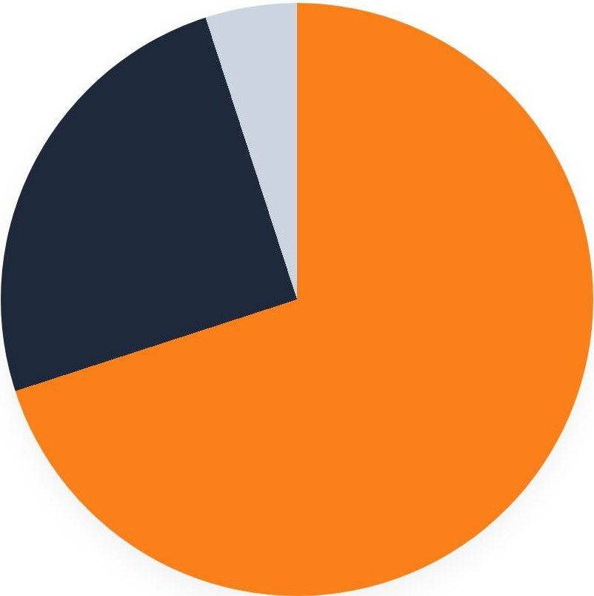



Deliver
Per ormance b
Plat orm
Android (Dominant)
iOS (Significant) Web (Very Low)
□ Mobile-First Landscape: The same pattern emerges in both cities. Most successful deliveries are driven by mobile platforms, heavily skewed towards Android. Web-based orders contribute very little to the overall fulfillment volume.

Slide 9
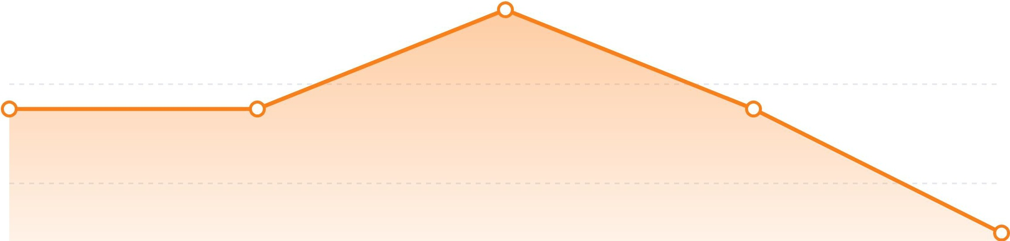
Revenue Trends
2025
f16L
f14L
f12L
f10L
Jan
Apr
May-Aug Peak
Nov
Dec
Consistent Revenue: Stable at �14-15.5 lakh/month. Bangalore is marginally higher. Peak Period: May-August sees a spike due to seasonal demand and campaigns. Drop: Noticeable decline in December 2025.

Slide 10
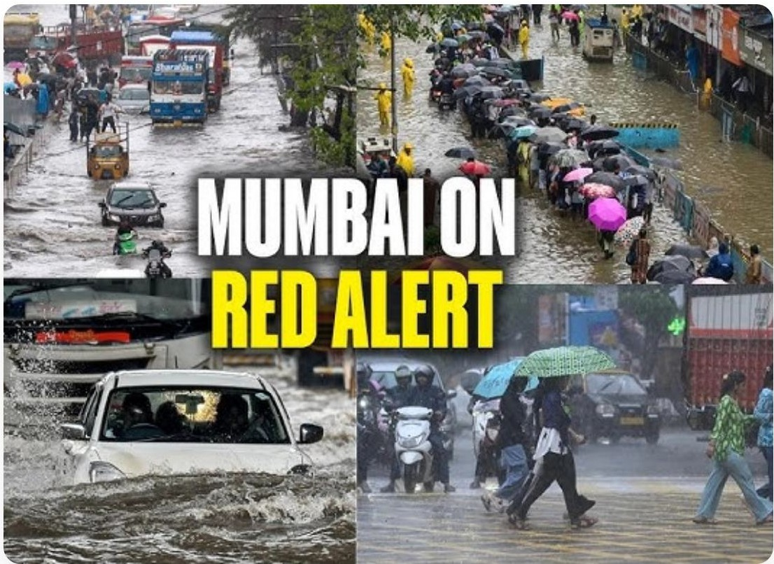
•
Rain Causes Significant Delays
In both cities, active rain conditions increase the average
de�ry time by approximately
Ill
8 to 9 minutes
. This indicates a common operational bottleneck.
•
Bangalore takes longer
Overall, Bangalore deliveries take longer than Hyderabad regardless of weather conditions. This could be attributed to:
o Higher traffic density
o Larger geographical city spread
o Differing weather intensity

Slide 11




Cam Cl
•
•
n Per ormance Anal SIS
Push Notifications
Email Campaigns
Popup Ads
Key Takeaway: Email and Push campaigns prove significantly more effective than Popup campaigns in Bangalore. Meanwhile, Push notifications act as the primary driver for better user engagement in Hyderabad.

Slide 12





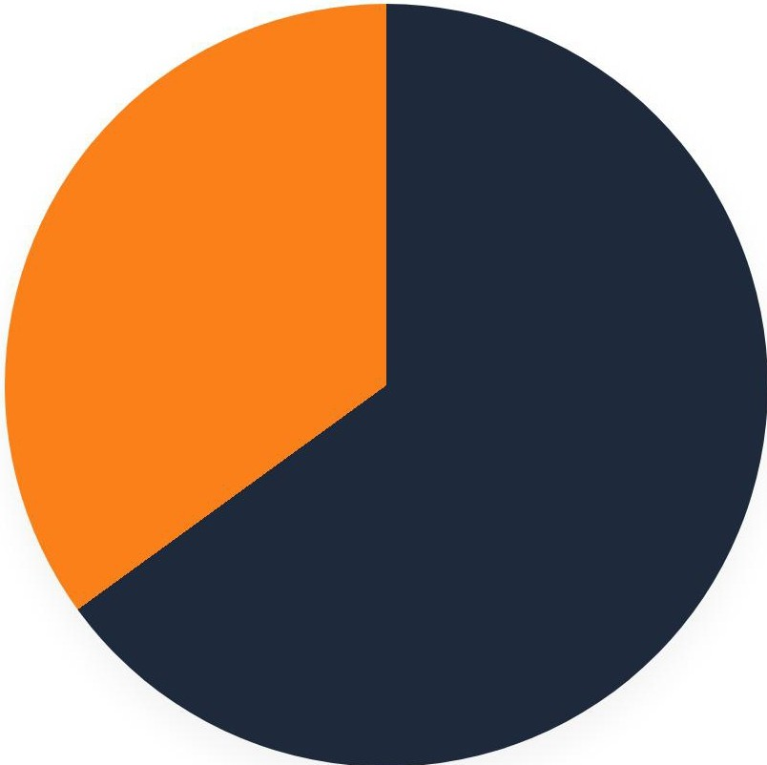


Cam Cl
•
n vs No Cam Cl
•
Organic/ No Campaign (65%)
Campaign Driven (35%)
The majority of orders occur organically without direct campaign intervention. However, campaigns still contribute a highly significant 35%, proving they successfully drive incremental demand. Customer behavior and order distribution remain consistent across both cities.

Slide 13



Focus Areas & Re
uired Im
rovements
Improve Delivery Efficiency
Reduce transit times, particularly during rainy conditions.
Strategically increase delivery partner availability during seasonal peaks and rush hours.
Strengthen Mobile-First
Concentrate development efforts on Android and iOS platforms where the vast majority of successful deliveries originate.
Enhance app UX.
Optimize Campaigns
Reallocate budget toward high-performing channels like Push and Email. Redesign or phase out low-converting Popup campaigns.

Slide 14
Strate
ic Recommendations
liil Control Coupon Burn
�- Leverage Data for Decisions
Optimize promotional spend to maximize ROI.
Focus on high-conversion, low-burn coupons.
Avoid excessive discounting that harms margins.
Deploy coupons strategically for acquiring new users and driving repeat purchases.
Maintain an agile operational posture through continuous monitoring.
Monitor KPls regularly (Orders, CTR, Delivery Time, Revenue).
Use granular data insights to drive continuous product and logistics improvement.

Slide 15







•
Opening the floor for questions and discussion.
�Syed Abdul Bari
II bariabdul3333@gmail.com
II Linkedln: Syed Abdul Bari

